Slide 1
47th RA IV Hurricane Committee
Ocean Panel
The Hurricane Committee’s Ocean Panel as a Catalyst for Rapid Progress in Earth System Observations and Forecasting
Scott Glenn
Distinguished Professor, Rutgers University, USA
Thursday, 03rd April 2025, 16:15 -18:00 UTC
San Salvador, El Salvador

Slide 2
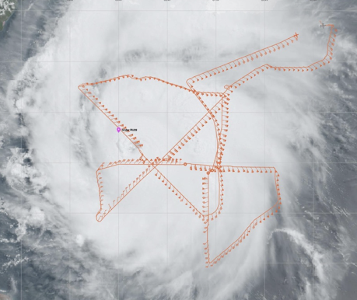
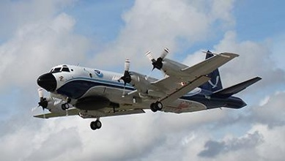
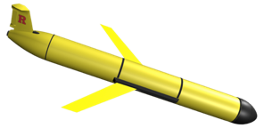
Tropical Cyclone Exemplar: Co-Designing Ocean Observing Systems for Improving Understanding and Forecasting of Tropical Cyclones
Co-Leads:
Scott Glenn – Rutgers University
glenn@marine.rutgers.edu
Cheyenne Stienbarger – NOAA
cheyenne.stienbarger@noaa.gov
Plus International Steering Team
2024 Highlight: NOAA P3 Hurricane Hunter Track in Cat 5 Hurricane Beryl over Hurricane Glider RU29 in the Caribbean.

Slide 3
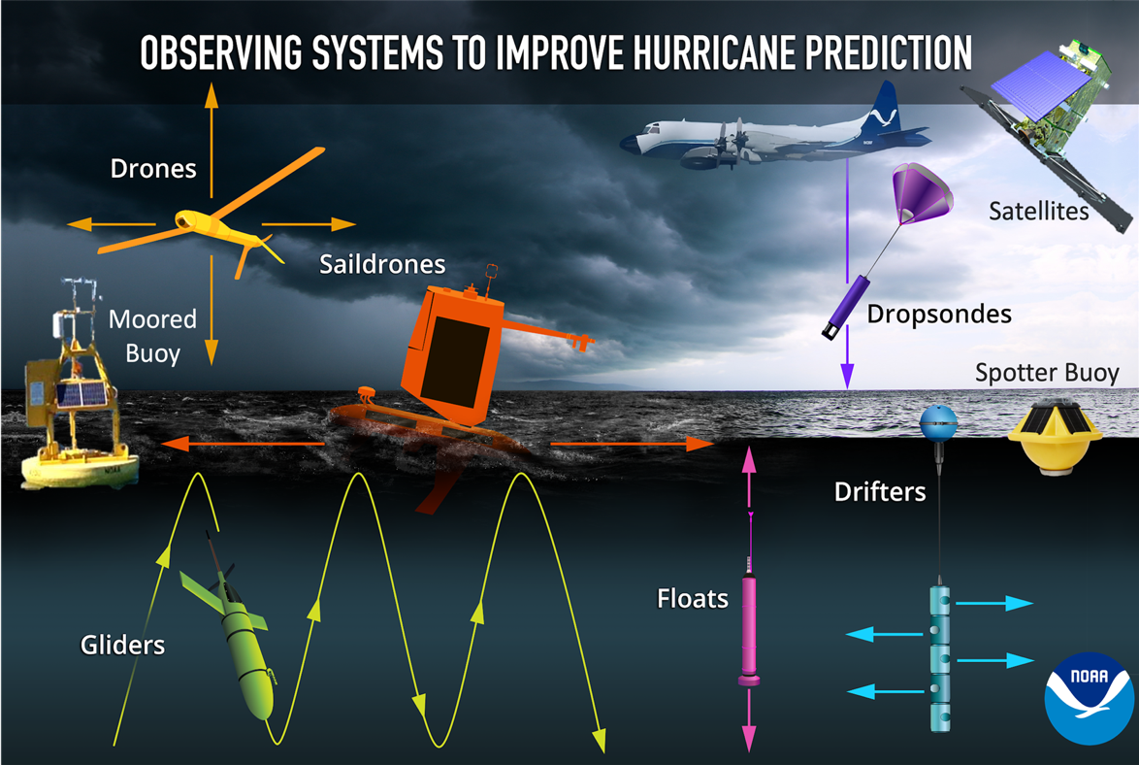
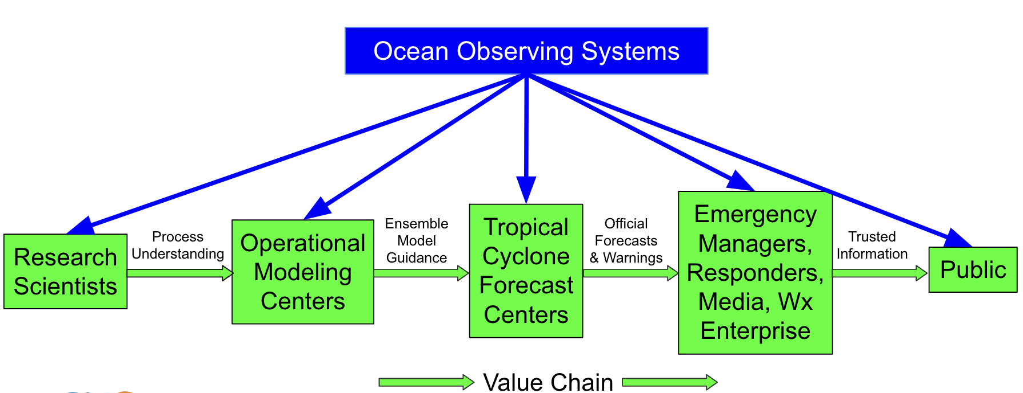
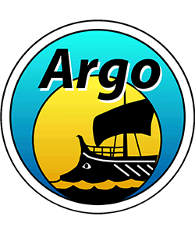
Tropical Cyclone Exemplar Co-Design Starting Point: Numerous technologies demonstrated to improve hurricane forecasts
Co-Design
Process
Requirements
“There is a dearth of subsurface profile data”
- NOAA Environmental Modeling Center (EMC)
GOOS/WIGOS
Observations Coordination Group
>15 Global Observing Networks
FVON
Fishing Vessel Observing Network
Leveraging two GOOS Mature Networks since 2018
Adding an Emerging Network in 2025
Notes:
SG

Slide 4
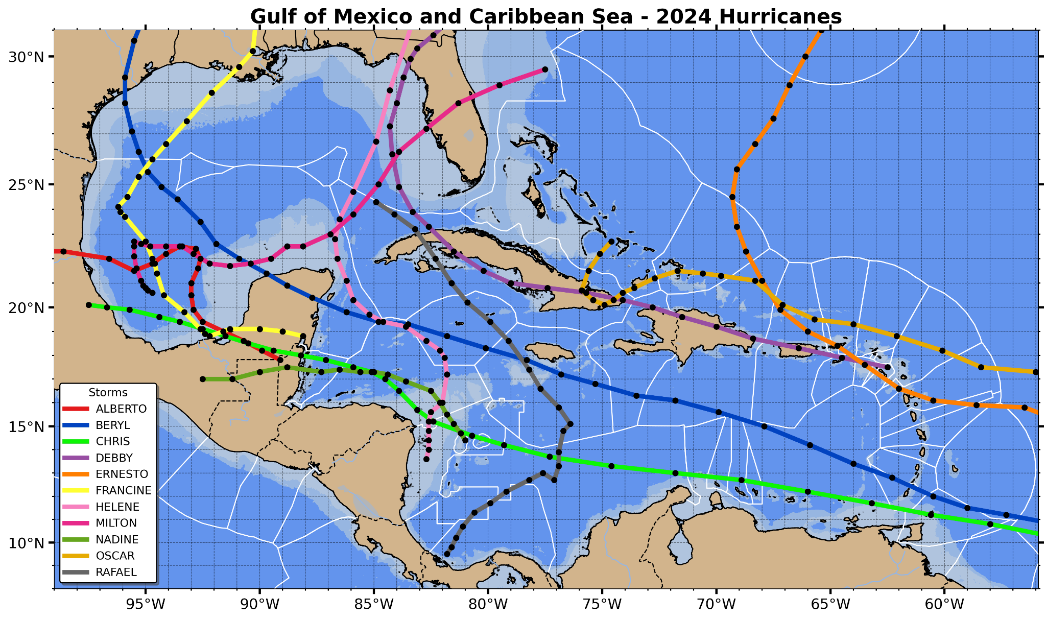
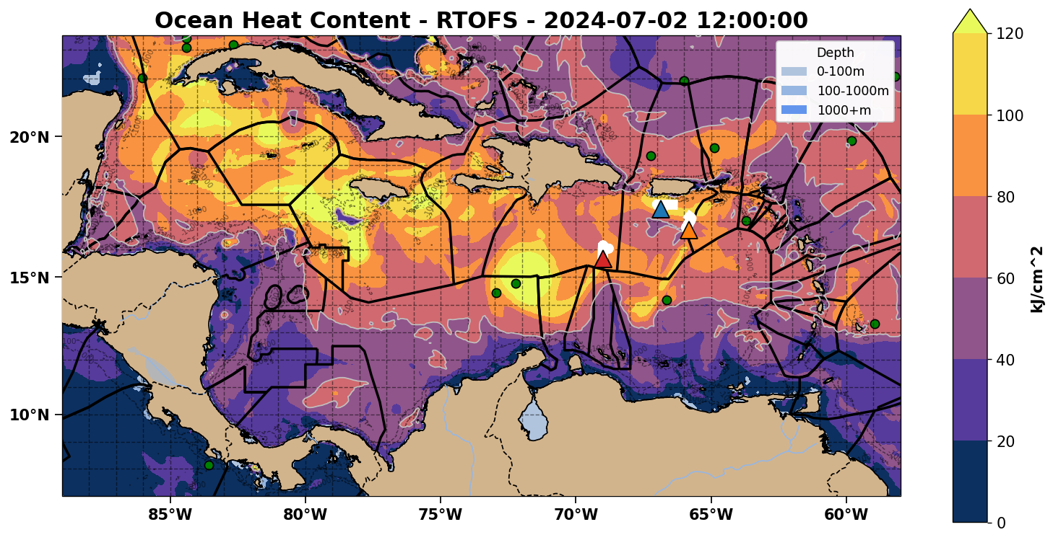
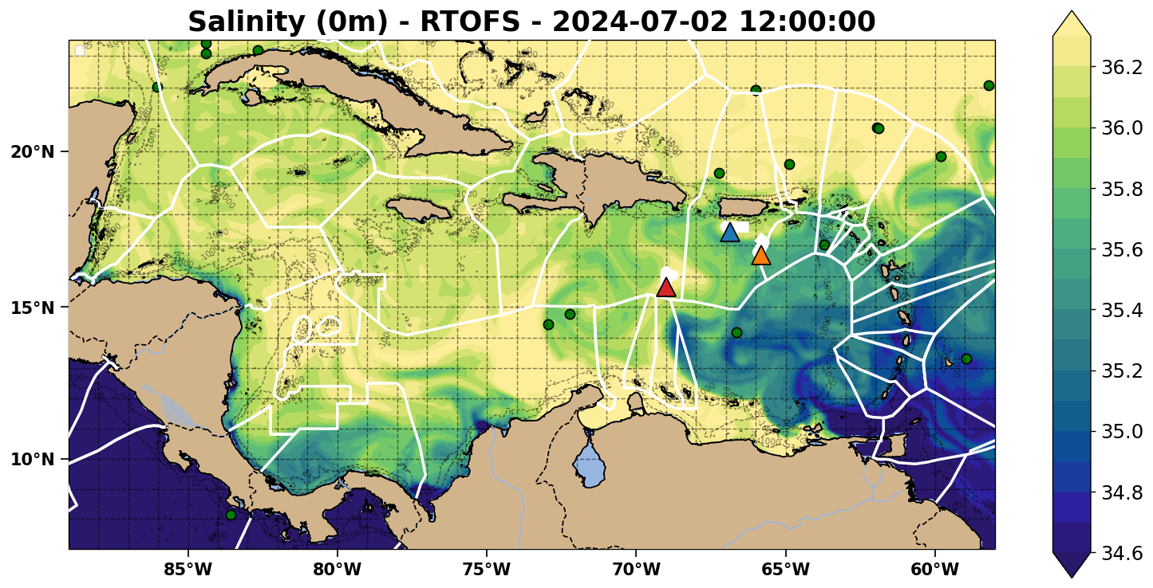
2024 Hurricane Tracks
Essential Ocean Features Affecting Hurricane Intensity
Ocean Heat Content
Low Surface Salinity for Barrier Layers
Hurricane Tracks & Essential Ocean Features cover the full Caribbean!

Slide 5
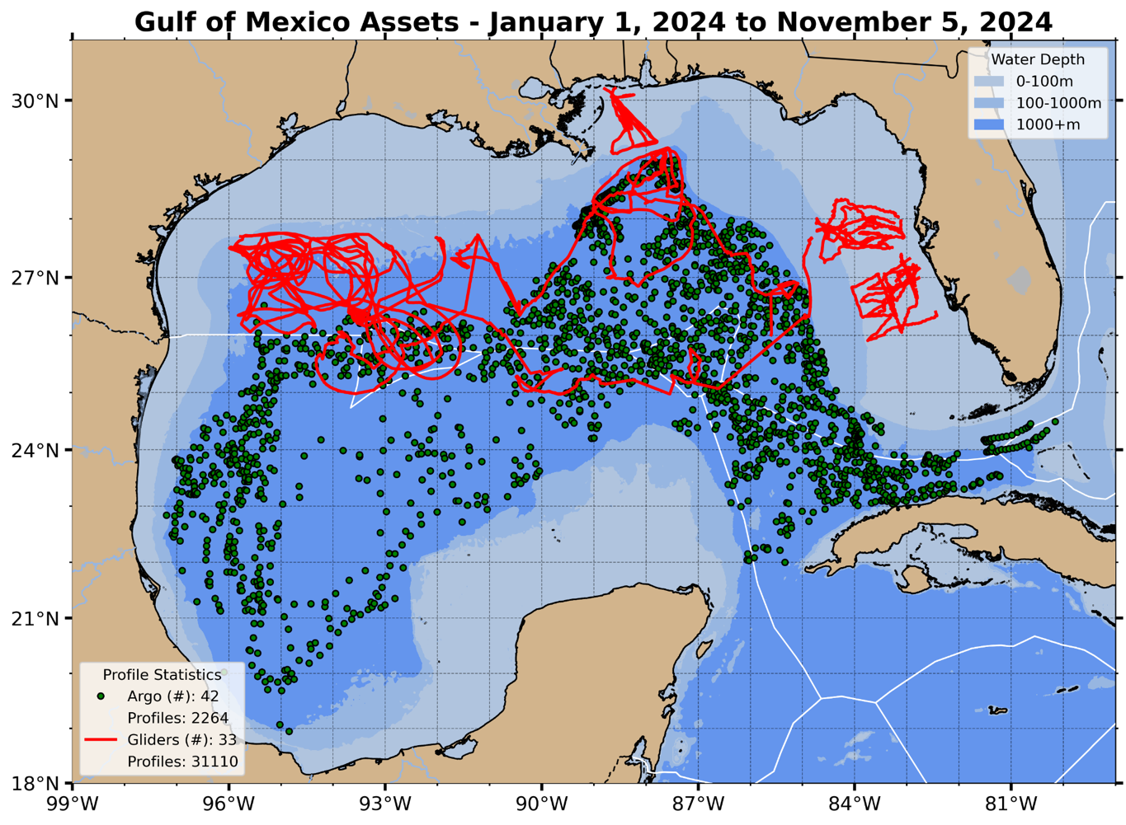
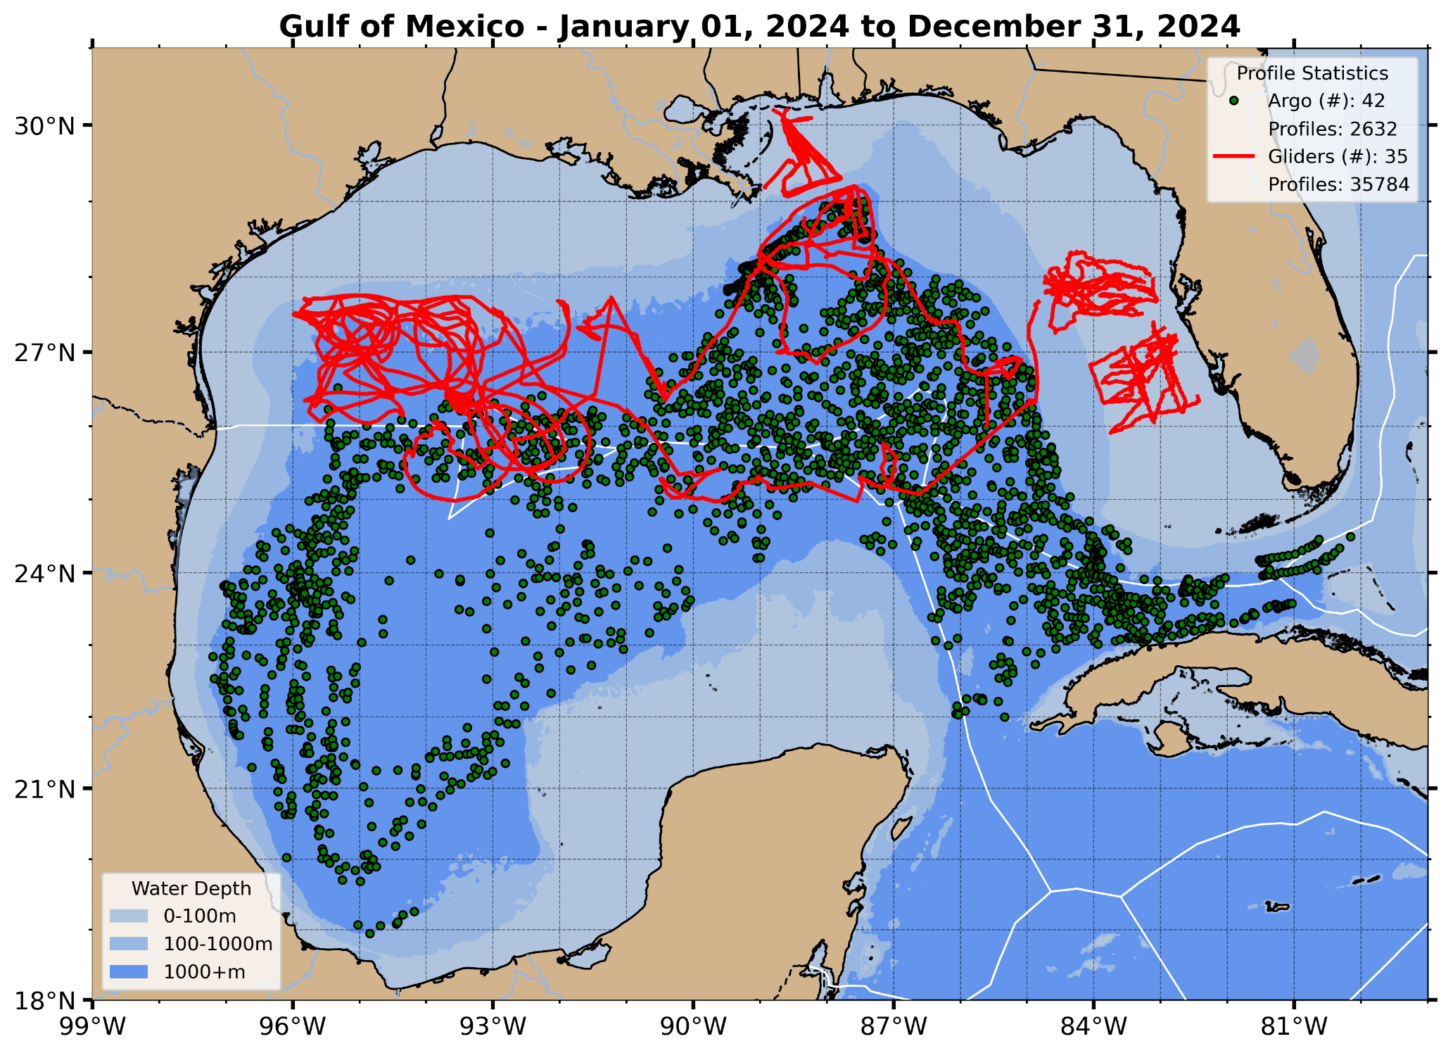
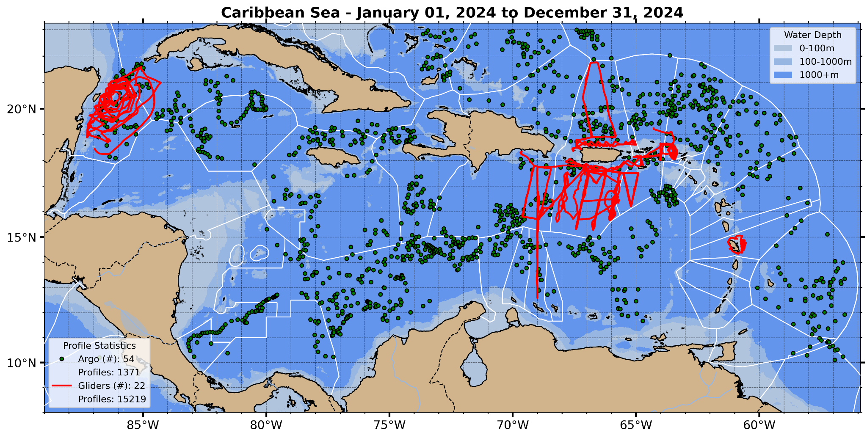
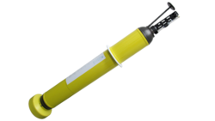
Profile Data Available for Assimilation
2024 | Gulf of Mexico | Caribbean Sea
Surface Area | 1.55M km² | 2.75M km²
Argo Profiles | 2,632 | 1,371
Glider Profiles | 35,784 | 15,219
Argo Glider

Slide 6
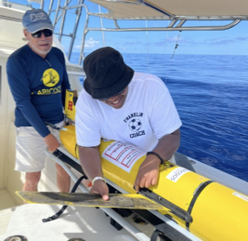
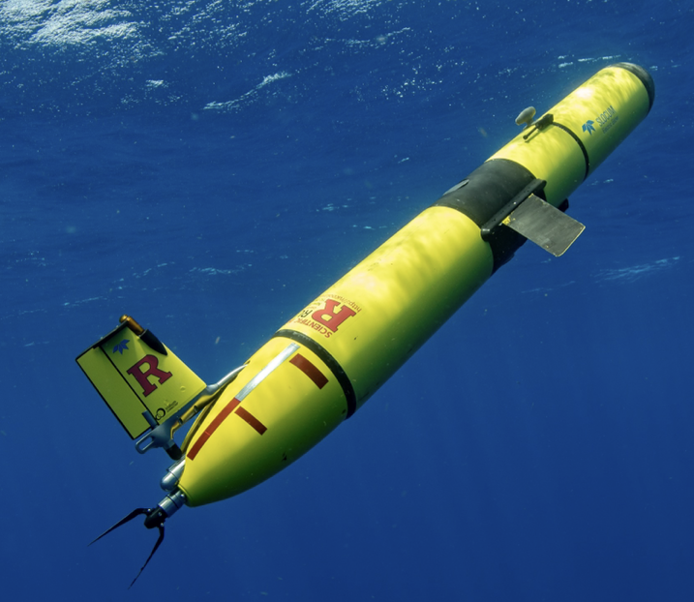
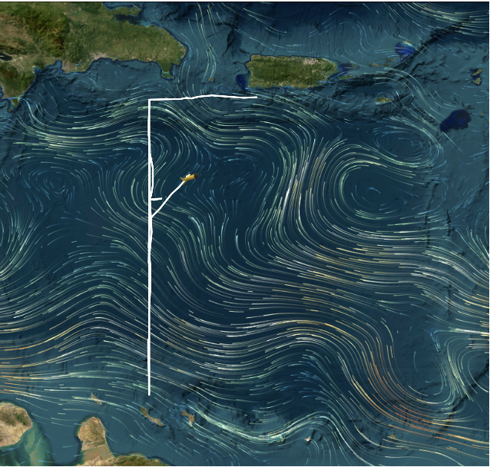
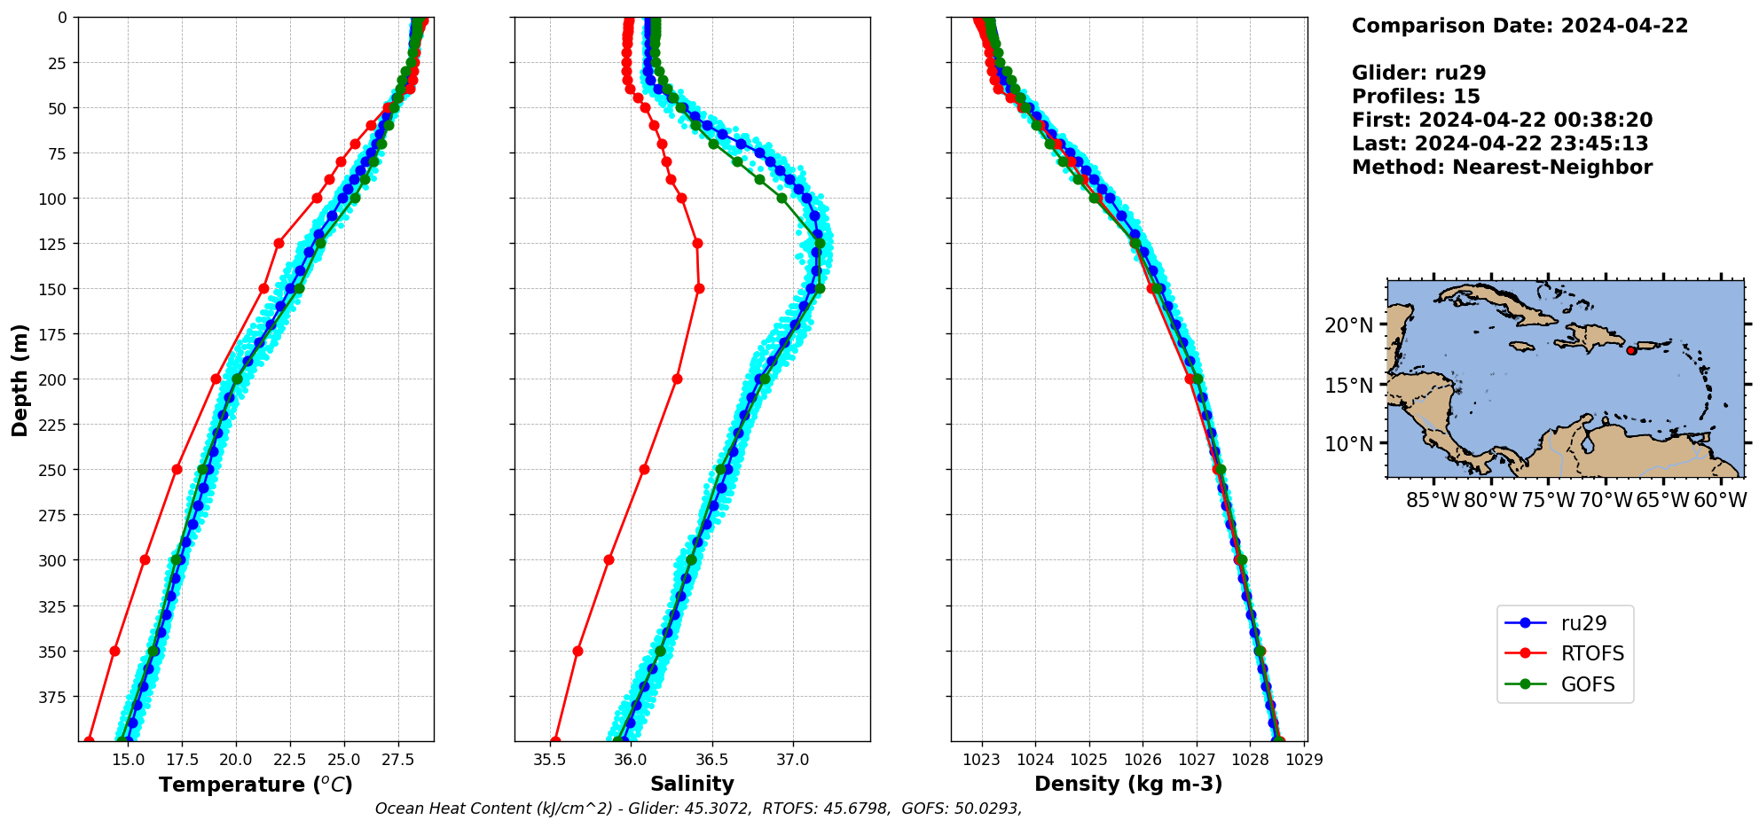
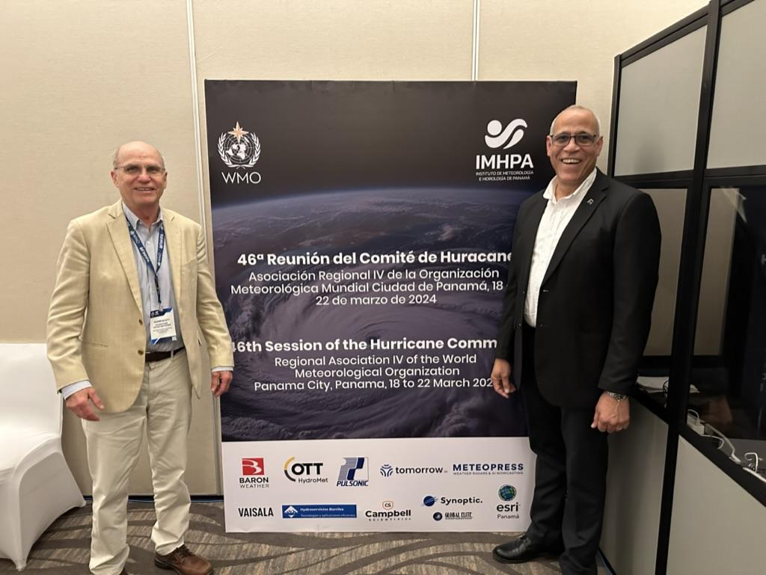
Caribbean Throughflow Glider Mission
Puerto Rico
Exploratory Repeat Transect: Puerto Rico to
Dominican Republic to
Curacao
Before Glider Data Assimilation -
ROTFS Operational Model is Biased Cold & Fresh
Curacao
Funded by:
WMO Region IV
Coordination
Temp
Salinity
Notes:
SG

Slide 7
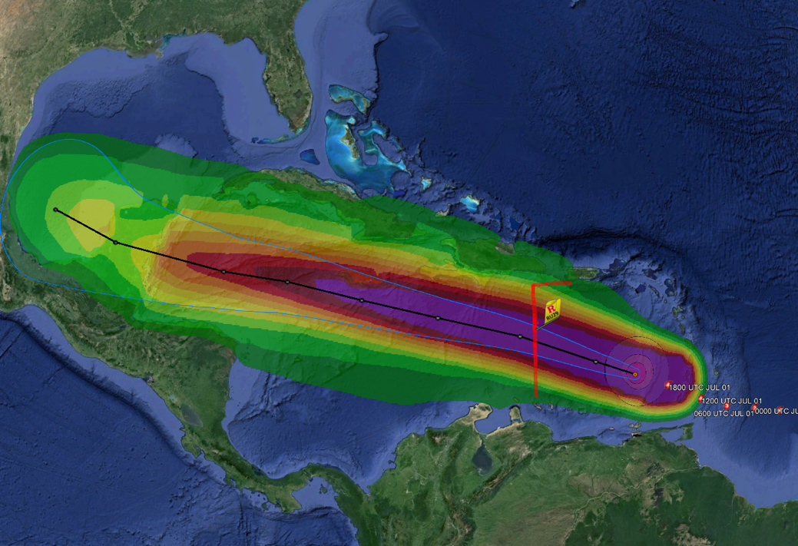
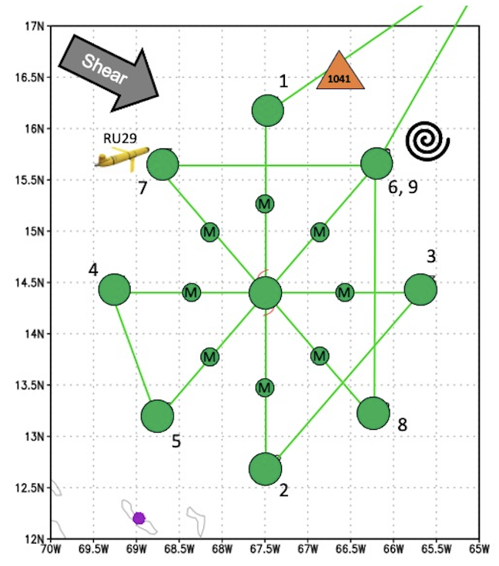
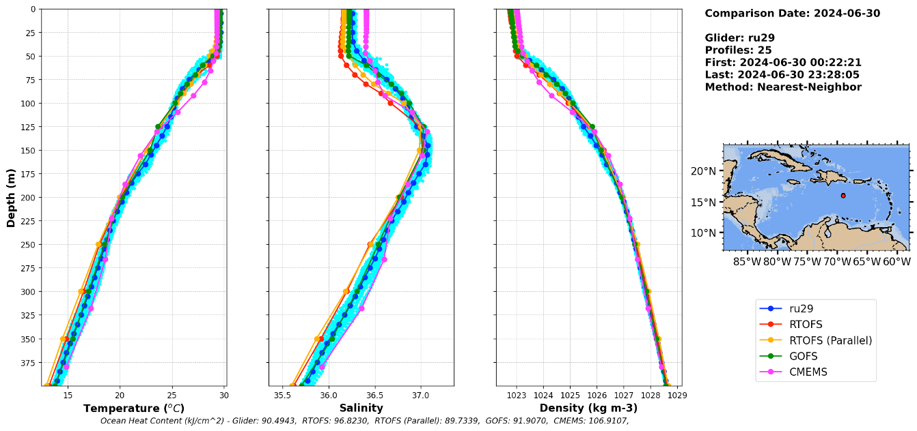
BERYL - Hurricane Hunter & Hurricane Glider Coordination
Glider data is shared on the GTS in real time and assimilated in operational ocean models used for hurricane forecasts
World Record: Closest approach of any uncrewed underwater system to a hurricane eye.
NOAA
NOAA P3 Hurricane Hunter dropsonde deployments coordinated with underwater glider RU29 location in Cat 5 Hurricane Beryl
Already engaged five early career scientists in Caribbean hurricane research
After Glider Data Assimilation -
ROTFS Operational Model (and others) all improved
Temp
Salinity
Operational hurricane forecasts and research enabled by the same datasets!
Notes:
SG

Slide 8
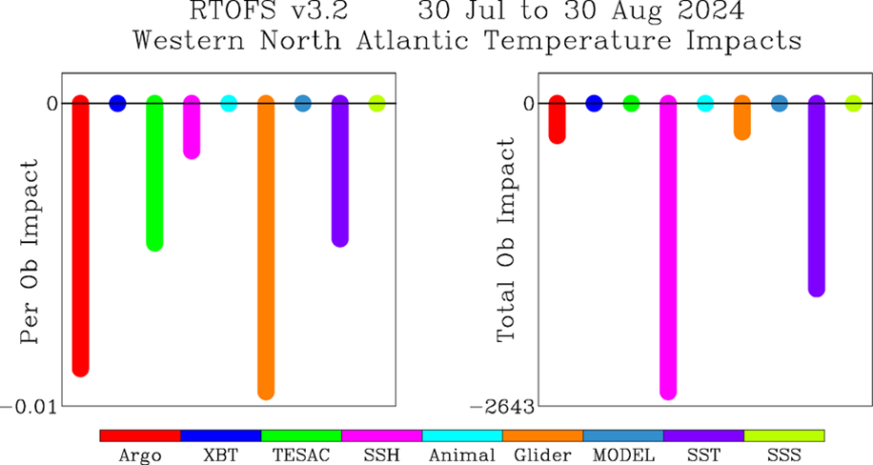
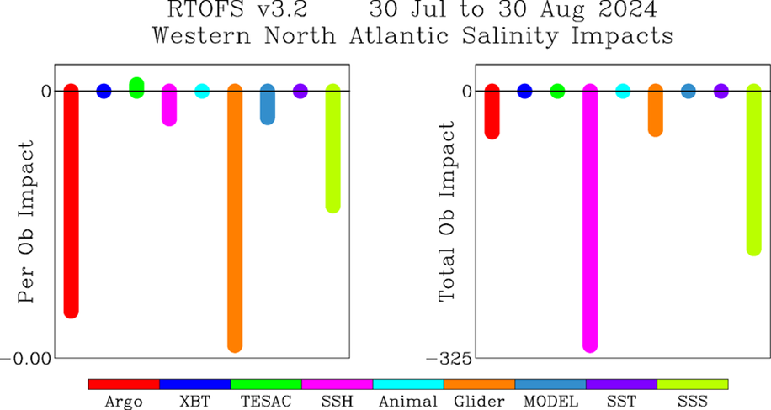
RTOFS Adjoint Model - Profile Assimilation Impacts
Temperature
Salinity
Per Ob
Total
Per Ob
Total
On a per observation basis (blue boxes), T&S profiles from Argo and Gliders outperformed all other data observing systems, including Satellite Altimetry (SSH).
This supports the idea that prioritizing T&S profiles could improve RTOFS performance the most.
Results from NOAA Environmental Modeling Center (EMC)

Slide 9
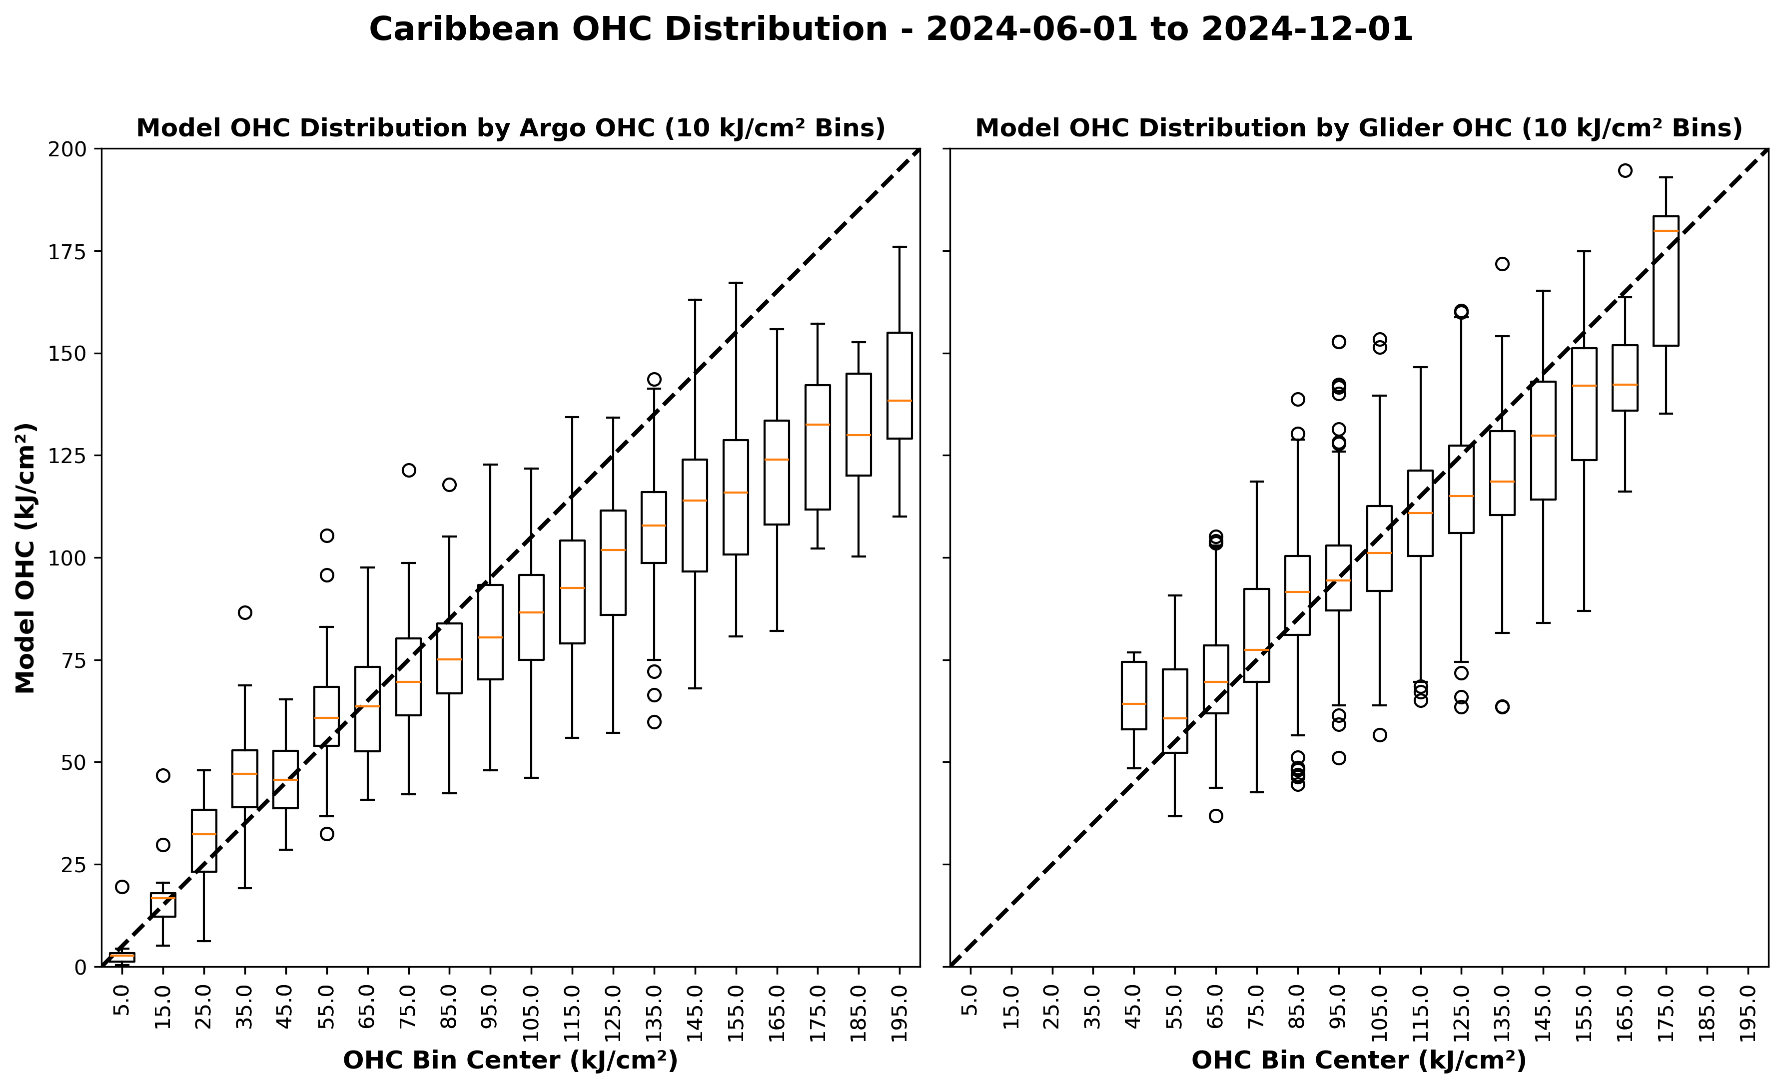
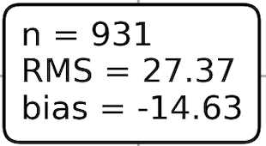
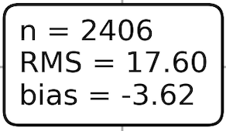
Argo & Glider comparison to operational RTOFS model
Before each Profile is Assimilated
RTOFS
Cold Bias
Argo
Glider

Slide 10
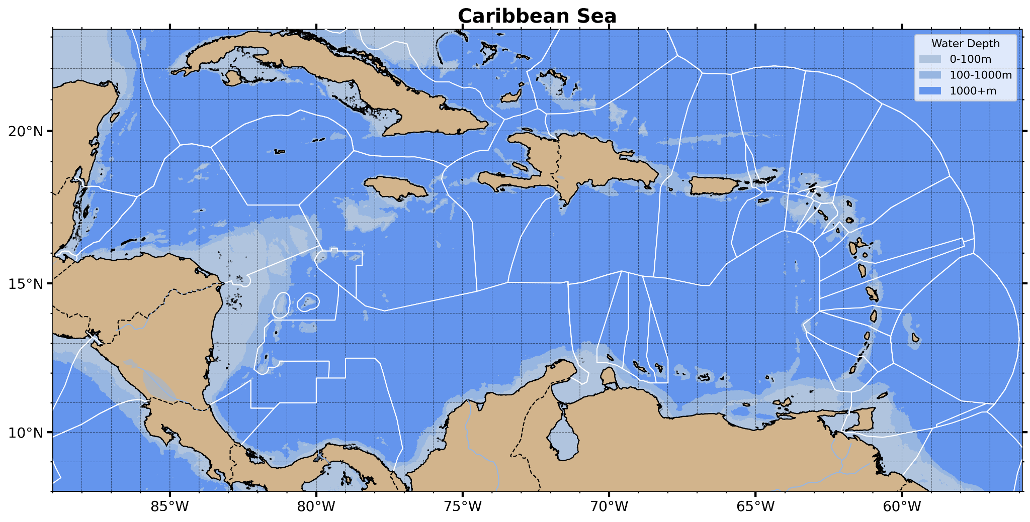
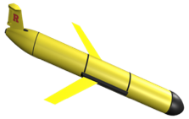
2025 Planned Caribbean Profile Observations
OceanGliders + Argo + Fishing Vessel Observation Network (FVON) provide real-time profile data for assimilation by hurricane forecast models
North Atlantic Inflow - PR-USVI-BVI
(US Hurricane Gliders)
Throughflow -
DR to Curacao
(2024 Vetlesen to US NSF)
Throughflow - Nicaraguan Bank (US NSF)
Yucatan Outflow -
Mexico
(US NAS/ Mexico)
South Atlantic Inflow - Barbados to Guyana (2025 Vetlesen)

Slide 11
Key messages/recommendations to HC-47
Key Messages:
Caribbean is undersampled; Profile data is especially sparse
Operational ocean model is biased cold and fresh; Assimilation of daily profile data is especially good at improving the ocean component of coupled hurricane forecast models
2024 Glider demonstration projects (Yucatan, DR to Curacao, Martinique) used the cumbersome Marine Scientific Research (MSR) permission process to demonstrate value to both research and operations
Inspired by 2024 successes, 2025 hurricane season is an opportunity to demonstrate the value of even broader Caribbean-wide participation and three GOOS networks (OceanGliders + Argo + FVON)
Caribbean is process rich; Process and data rich regions are a magnet for early career scientists
Recommendations:
Accelerate the transition from Marine Scientific Research permissions to regional agreements for operational monitoring across national jurisdictions (e.g. CARICOM; Mexico-Cuba).
Together expand foundation support for demonstration projects that establish new Glider-ports and new Glider operational areas
Leverage existing excess capacity & experience (e.g., U.S. & Mexico) while building the Caribbean Glider Fleet and training local Glider operators
Provide RA IV Hurricane Committee endorsements to entities seeking funding for improved ocean observing

Slide 12
Gracias Thank you Merci
^{wmo.int}

